Slide 1
Annie E. Casey Foundation
Reform Trends in Juvenile Justice:
Reducing Reliance on Detention and Incarceration
FEDERAL ADVISORY COMMITTEE
on JUVENILE JUSTICE
U.S. Department of Justice
October 19, 2012
Bart Lubow, Director
Juvenile Justice Strategy Group
Annie E. Casey Foundation

Slide 2
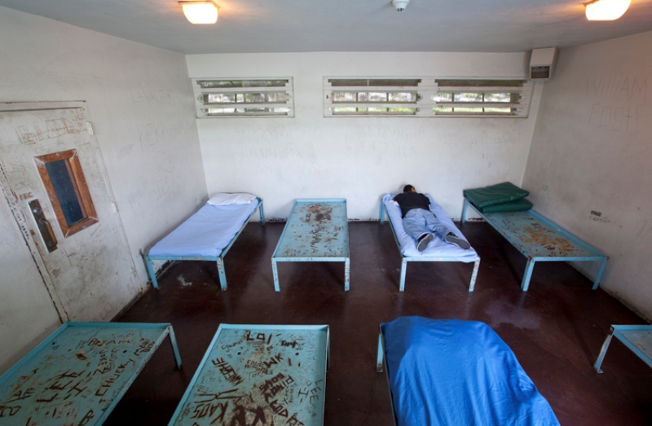
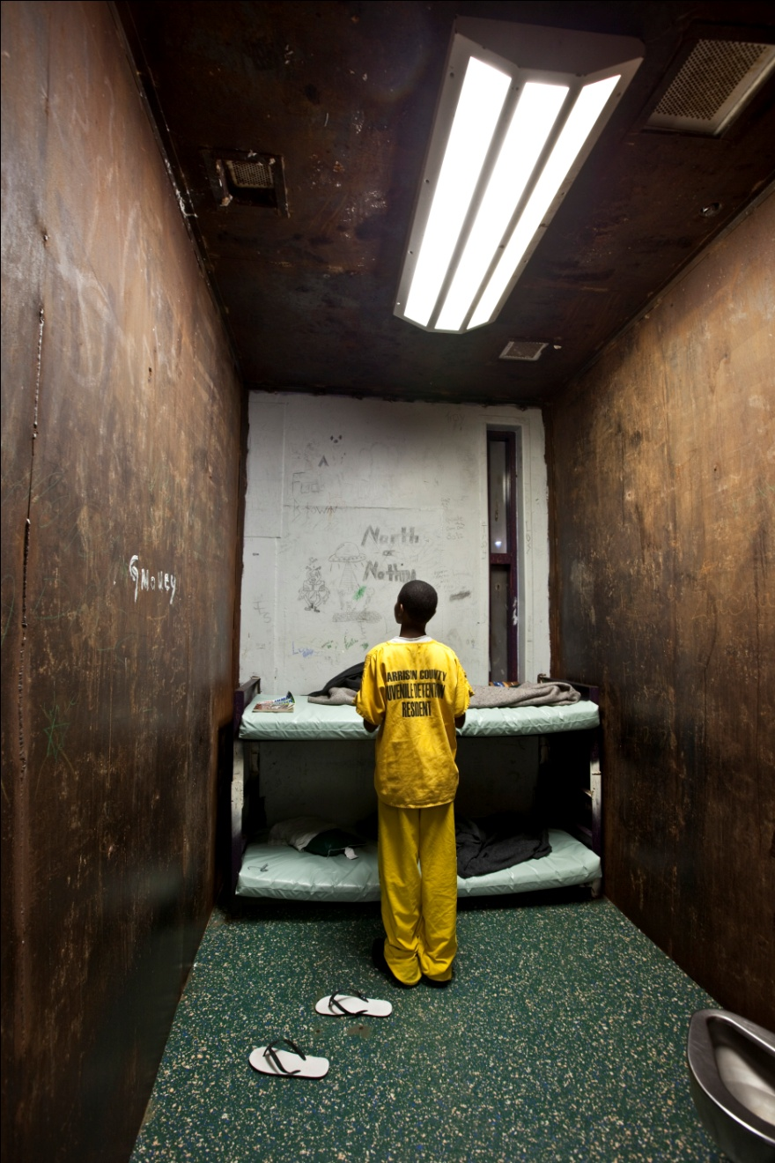
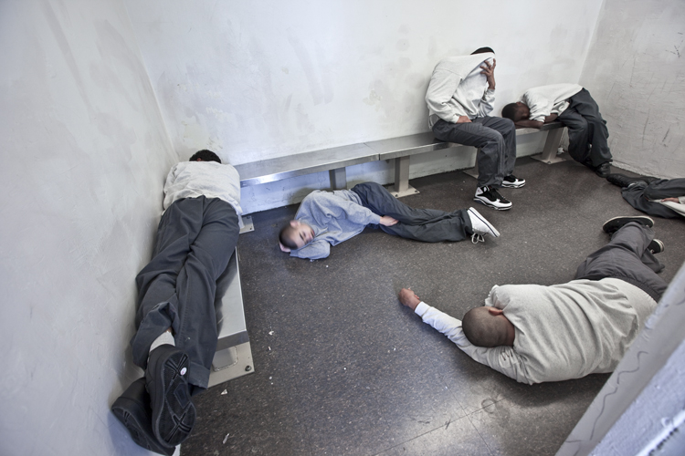
NO PLACE FOR KIDS
All photos © Richard Ross

Slide 3
America’s heavy reliance on juvenile incarceration is unique among the world’s advanced nations
JUVENILE INCARCERATION RATE:
US vs. other nations
Per 100,000 youth
SOURCE: Hazel, Neal, Cross-National Comparison of Youth Justice (London: Youth Justice Board, 2008)

Slide 4
Incarceration is an often harmful and ineffective method of addressing delinquent behavior
Increased Likelihood Of Adult Criminality By JJ Intervention Type
Likelihood Of Behavior: Incarcerated Vs. Non-incarcerated Youth
38x
System involvement alone doubled the likelihood
of arrest as
an adult
14x
2x
JJ Intervention, No Supervision
With Supervision
With Placement
Youth who are held in detention are more than three times as likely to subsequently be found guilty and incarcerated than similar peers
After release, incarcerated youth are more likely to drop out of school and use drugs & alcohol
Even after controlling for seriousness of offense, prior record and multiple other factors, youth who were placed in juvenile facilities were 38 times more likely to be arrested as adults
SOURCES: Office of State Courts Administrator, Florida Juvenile Delinquency Court Assessment (2003); LeBlanc, (1991), “Unlocking Learning” in Correctional Facilities, Washington, D.C Substance use, abuse, and dependence among youths who have been in jail or a detention center: The NSDUH report, The National Center on Addiction and Substance Abuse (CASA) at Columbia University, (2004); America’s Promise report on national rates of high school dropouts: www.msnbc.msn.com/id/23889321/; Tremblay, R.E., Gatti, U., & Vitaro, F. (2009). Iatrogenic Effect of Juvenile Justice. The Journal of Child Psychology and Psychiatry, 50:8, 991-998.

Slide 5
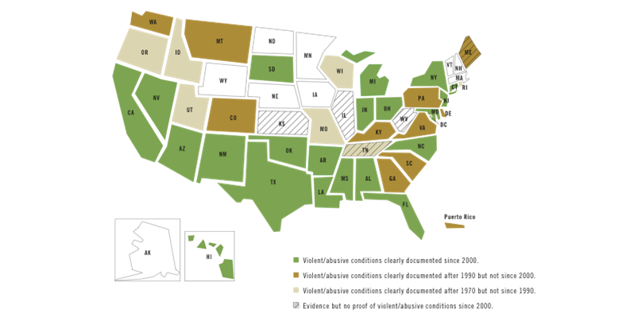
The Deep End of the Juvenile Justice System is:
DANGEROUS
SYSTEMIC OR RECURRING MALTREATMENT IN JUVENILE CORRECTIONS FACILITIES IN THE STATES: 1970 TO PRESENT
For this map, “systemic or recurring maltreatment” is identified when clear evidence has emerged from federal investigation, class-action lawsuits, or authoritative reports written by reputable media outlets or respected public or private agencies showing that – at least at one particular time – one or more state-funded youth corrections facilities repeatedly failed to protect youth from violence by staff or other youth, sexual assaults, and/or excessive use of isolation or restraints. “Evidence but no proof” is indicated when credible reports of maltreatment have emerged, but not enough to satisfy the above criteria.
For more information, visit www.aecf.org/noplaceforkids.
5

Slide 6
The Deep End of the Juvenile Justice System is:
INEFFECTIVE
RECIDIVISM RATES BY STATE
Rearrest – Any Delinquent Offense (Misd or Felony)
NY²
HI
CA/ MD
NC
NY
VA
SC¹
VA
NY
MD
DE
SC
FL
MD
NY
SC
VA
OK
¹ At age 21
² At age 28, boys only. Comparable rate for girls was 82%
SOURCES: Virginia Department of Juvenile Justice. (2005) Juvenile recidivism in Virginia. DJJ Research Quarterly. Richmond, VA: VDJJ; J. Travis, et al. Charting a New Course, A Blueprint for Transforming Juvenile Justice in New York State: A Report of Governor David Paterson’s Task Force on Transforming Juvenile Justice. (New York: December 2009).

Slide 7
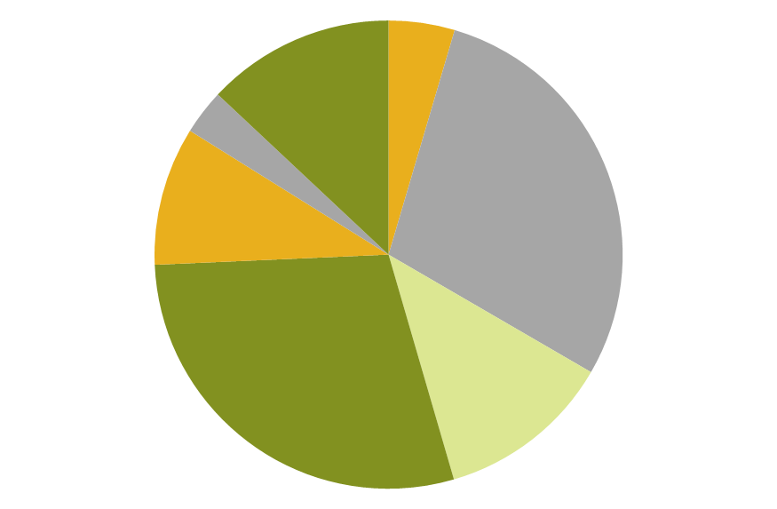
The Deep End of the Juvenile Justice System is:
UNNECESSARY
MOST SERIOUS OFFENSE OF ALL COMMITTED YOUTH IN THE U.S.: 2007
Technical Violations
Public Order Offenses
11.7%
Status Offenses
2.8%
4.1%
Drug Offenses
8.6%
Homicide
Violent Index Offenses
Rape/Sexual Assault
25.9%
Robbery
Property Offenses
25.9%
Aggravated Assault
10.9%
Other Person Offenses
SOURCE: Sickmund, et al. (2011). “Easy Access to the Census of Juveniles in Residential Placement.” Available at www.ojjdp.gov/ojstatbb/ezacjrp.

Slide 8
The Deep End of the Juvenile Justice System is:
OBSOLETE
The state of Florida found that youth participating in the Redirection Program had better outcomes than comparable youth placed in residential facilities. They were:
9% less likely to be arrested for any new crime
15% less likely to be arrested for a new felony
14% less likely to be convicted of a new felony
35% less likely to be sentenced to an adult prison
The Redirection Program saved taxpayers $41.6 million over four years by steering less-serious offenders away from expensive residential confinement and by reducing recidivism.
Savings
Cost of Residential Placements Averted (2,033 youth) |  | $50.8 million
Savings from Reduced Recidvism |  | $5.2 million
Savings Subtotal |  |  | $56 million
Costs
Youth Referred for Treatment | 2,867
Youth Completing Treatment | 2,033
Cost of Redirection Treatment |  |  | $14.4 million
Net Savings (Subtotal – Costs) |  |  | $41.6 million
SOURCE: Florida Department of Program Policy Analysis and Government Accountability. Redirection Saves $36.4 million and Avoids $5.2 million in Recommitment and Prison Costs. Report No. 09-27, May 2009

Slide 9
The Deep End of the Juvenile Justice System is:
EXPENSIVE
ANNUAL COST OF JUVENILE INCARCERATION VS. OTHER YOUTH INVESTMENTS
SOURCES: American Correctional Association (for costs of youth incarceration; College Board (for costs at public universities and public two-year colleges), U.S. Census Bureau (for costs of public education), Cohen and Piquero (2008) (for costs of YouthBuild), and Public Private Ventures (for costs of Big Brothers Big Sisters program).
For more information, visit www.aecf.org/noplaceforkids.

Slide 10
The Deep End of the Juvenile Justice System is:
INADEQUATE
TRAUMATIC PASTS OF CONFINED YOUTH: PERCENTAGE OF YOUTH IN JUVENILE CORRECTIONAL FACILITIES WHO HAVE EVER:
ATTEMPTED SUICIDE
“SEEN SOMEONE SEVERELY INJURED OR KILLED”
“HAD SOMETHING VERY BAD OR TERRIBLE HAPPEN TO YOU”
SOURCE: Online data analysis of the Survey of Youth in Residential Placement, U.S. Office of Juvenile Justice and Delinquency Prevention

Slide 11
As a whole, juvenile incarceration in the United States is falling at an accelerating rate
Incarceration is on the decline
Among both detained and committed youth
More rapid & broad-based decreases since 2006 than prior
 | Annual Rate of Change 1996-2006 | Annual Rate of Change 2006-2010
Total | -2.1% | -6.5%
Detained | -1.2% | -5.9%
Committed | -2.6% | -6.9%
NATIONAL INCARCERATION TRENDS (1997-2010)
Source: Census of Juveniles in Residential Placement

Slide 12
While overall juvenile crime is also down, this does not tell the whole story
NATIONAL ARREST TRENDS (1997-2009)
Total arrests are down 31%, and most of this decline is explained by the drop in Violent Index Offenses which are down 30%
Nonindex offenses declined only 8% since 1997, and actually increased in the early 2000s
However, the number of committed youth in residential facilities has dropped by 36%, which means that it cannot be explained by changes in crime trends alone

Slide 13
Is it safe to reduce juvenile incarceration?
JUVENILE VIOLENT INDEX ARREST TRENDS IN STATES WITH DECLINING AND INCREASING JUVENILE CONFINEMENT RATES (1997-2007)
ATTEMPTED SUICIDE
“SEEN SOMEONE SEVERELY INJURED OR KILLED”
“HAD SOMETHING VERY BAD OR TERRIBLE HAPPEN TO YOU”
SOURCE: Author’s analysis, using data from the 1997 and 2007 Census of Juveniles in Residential Placement; and 1997 and 2007 FBI Arrest Statistics, both available at www.ojjdp.gov/ojstabb.

Slide 14
As of 2011, JDAI sites had reduced detention populations by 41%
Change in Average Daily Population (ADP) by Grantee
Baseline vs. 2011
N=33 grantees, comprising 94 sites
(Grantees shown in ascending order by percentage change in ADP)

Slide 15
Commitments to state facilities reduced 38% across reporting JDAI sites
Change in Commitments to State Custody by Grantee
Baseline vs. 2011
N=33 grantees, comprising 93 sites
(Grantees shown in ascending order by percentage change in ADP)

Slide 16
These declines have come without sacrificing public safety: JDAI sites report reductions in all four juvenile crime indicators
Aggregate Reductions in Juvenile Crime Indicator Type
Baseline vs. 2011
N=90 sites
47% fewer Delinquency Petitions
37% fewer Felony Petitions Filed
26% fewer Juvenile Intake Cases
34% fewer Juvenile Arrests

Slide 17
Compared with other jurisdictions in the same states, JDAI sites have seen deeper reductions in both detention and commitments to state custody
Detention ADP = Average daily population in secure detention. Baseline Year = Year prior to initiating JDAI detention reforms.
Source: Kirsberg, B. et al., An Evaluation of the Juvenile Detention Alternatives Initiative: JDAI Sites Compared to Home State Totals. (Chief justice Earl Warren Institute on Law and Social Policy, University of California – Berkeley: 2012 [publication forthcoming])

Slide 18
RECOMMENDATIONS
Limit who can be incarcerated/committed
Expand non-residential alternatives
Change the financial incentives
Adopt best juvenile justice practices
Implement Missouri Model
Use data to increase accountability for results

Slide 19
Why Reducing Incarceration is Key to Juvenile Justice Reform
The money is here
Comprehensive system reform will be required
Innovation will be stimulated
Outcomes become primary, rather than outputs

